Slide 1


Deep Feature Rotation for Multimodal Image Style Transfer
2021 8th NAFOSTED Conference on Information and Computer Science (NICS)
Son Truong Nguyen, Nguyen Quang Tuyen, Nguyen Hong Phuc

Slide 2
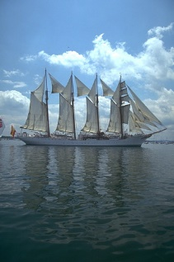
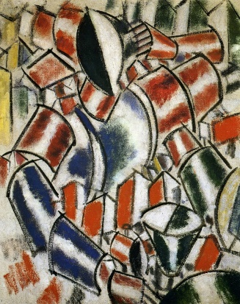
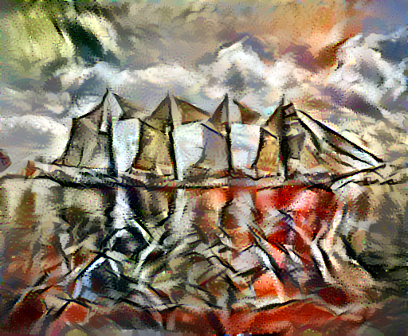
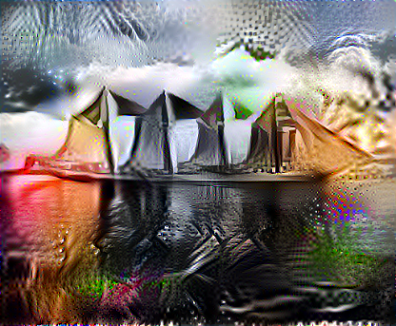
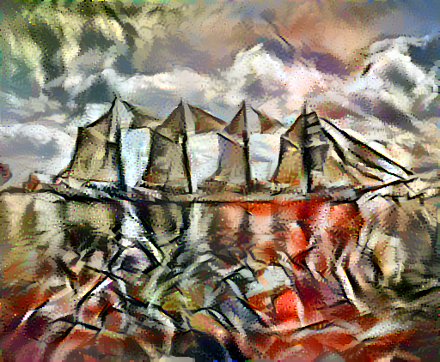
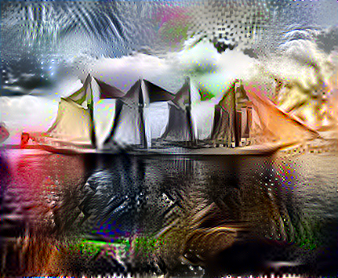
Outline
1. Introduction
2. Motivation
Input
Output
3. Proposed Method
4. Experimental results
5. Future works

Slide 3
1.
Introduction

Slide 4
What is Image style transfer?

Slide 5
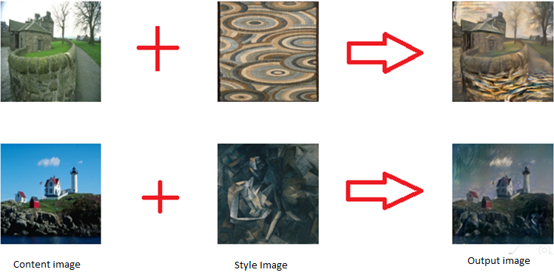
Image Style Transfer
5

Slide 6
2.
Motivation

Slide 7
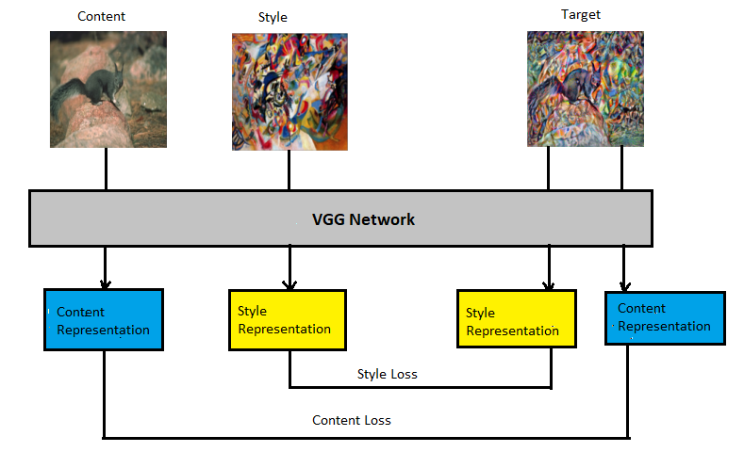
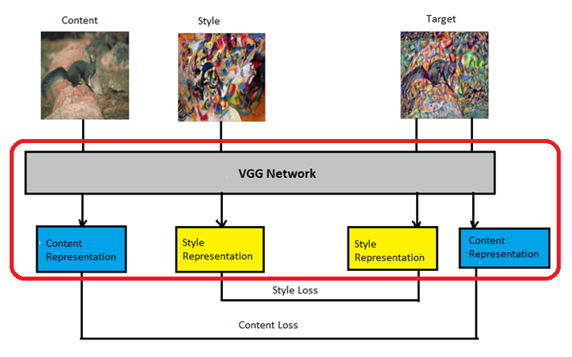
Previous Approaches
[1] Image Style Transfer using convolutional neural network, Gatys et al., CVPR 2016
7

Slide 8
Previous Approaches
Only one output can be generated for each content and style image pair
8

Slide 9
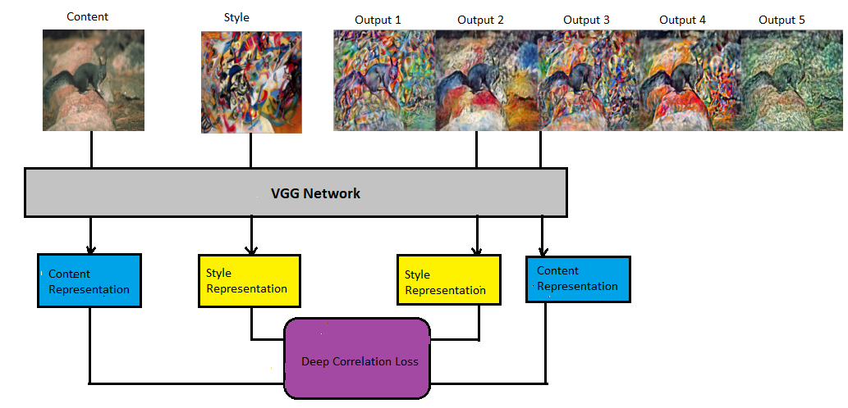
Previous Approaches
[1] Deep Correlation Multimodal Neural Style Transfer, Tuyen et al., IEEE Access

Slide 10
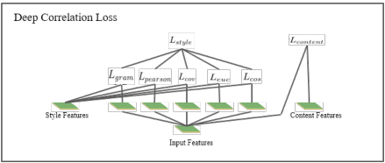
Previous Approaches

Slide 11
Previous Approaches
Slow down the back-propagation process, making it difficult to use in reality.

Slide 12
3. Proposed Method

Slide 13
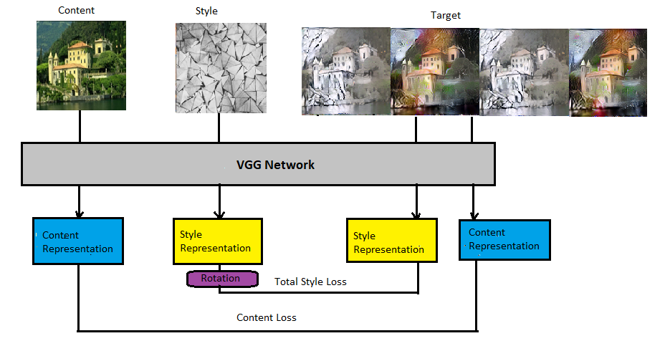


Slide 14
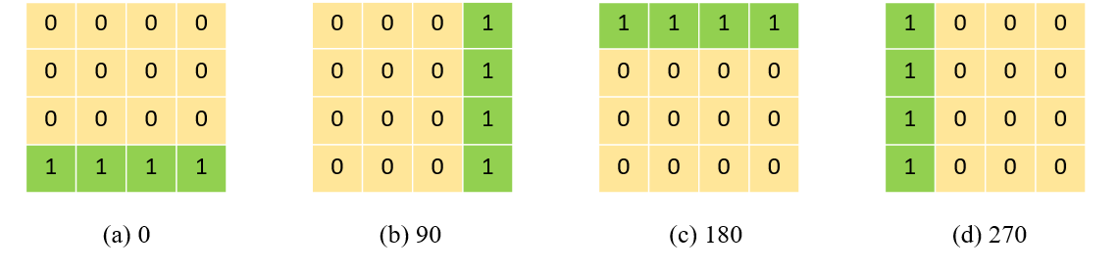
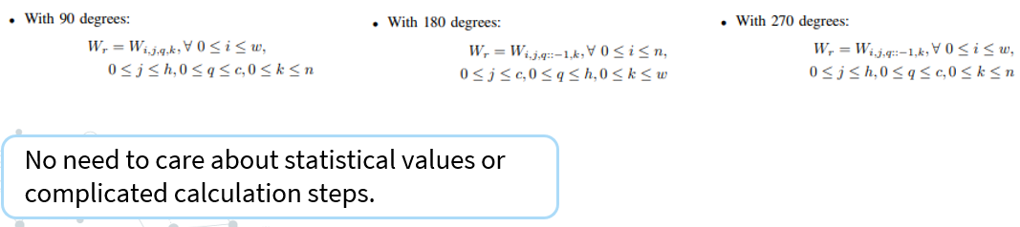
Illustration of Rotation Mechanism

Slide 15
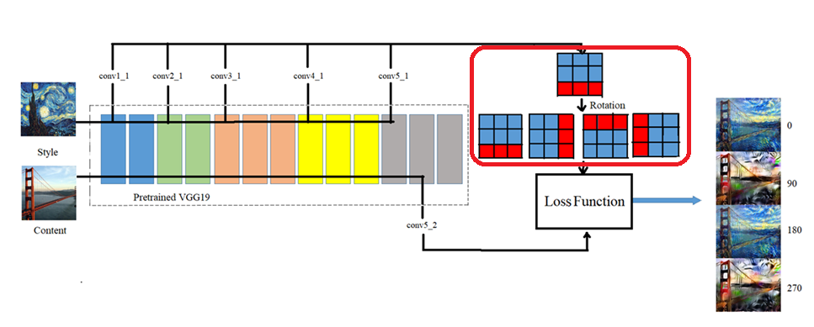
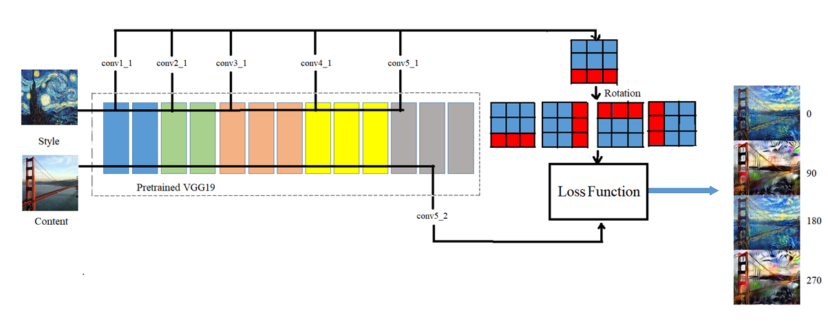
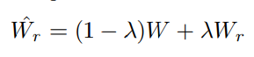
End-to-end style transfer model

Slide 16
4. Experimental Results
16

Slide 17
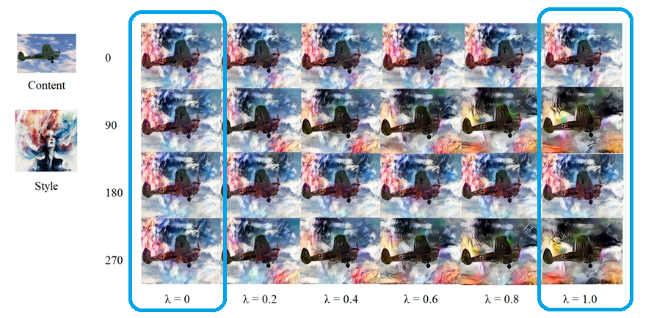
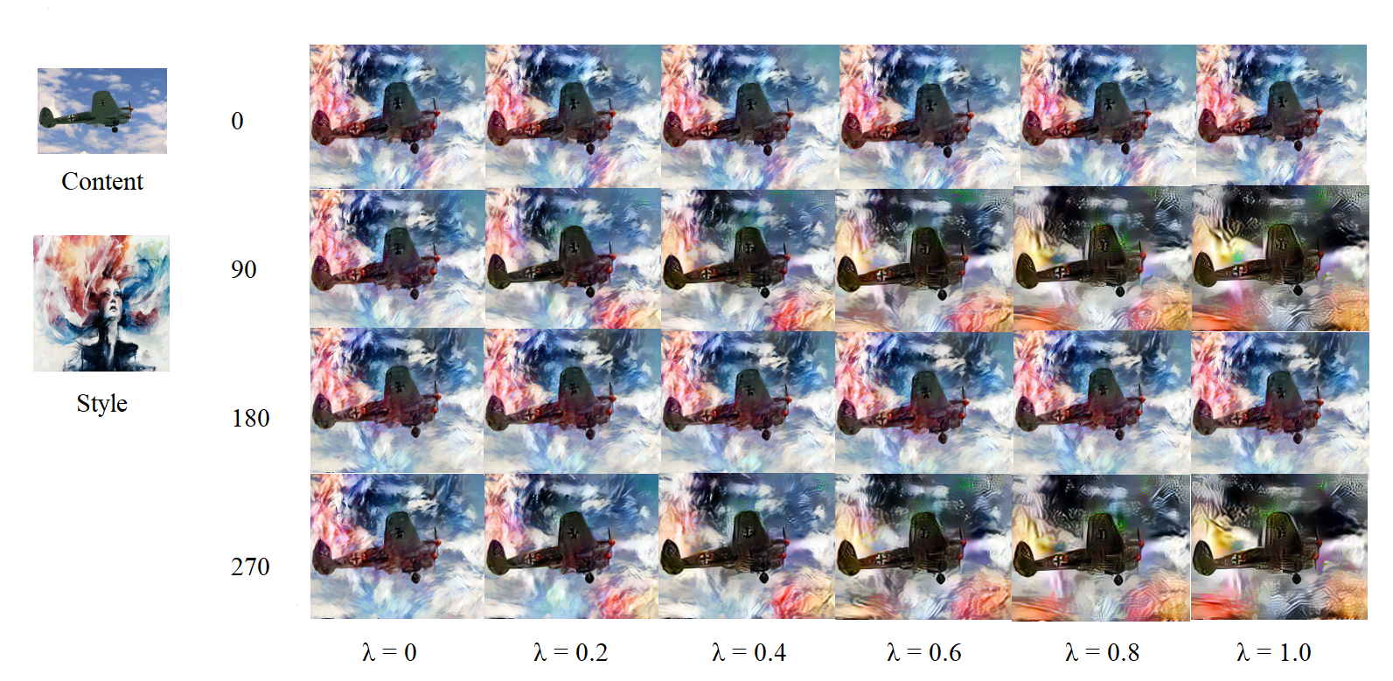
Qualitative Result

Slide 18
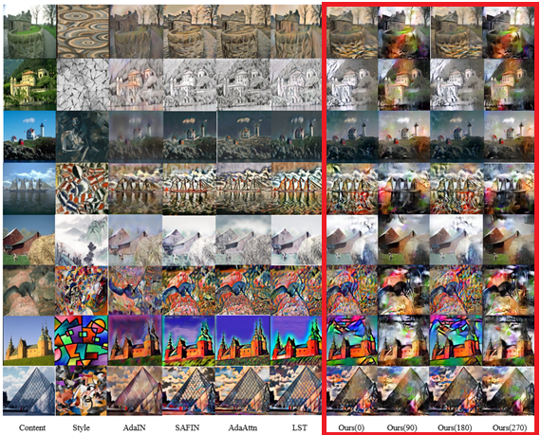
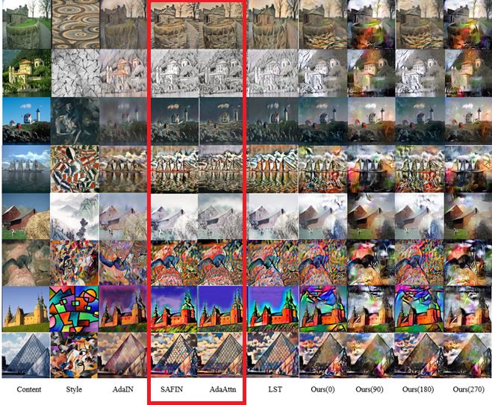
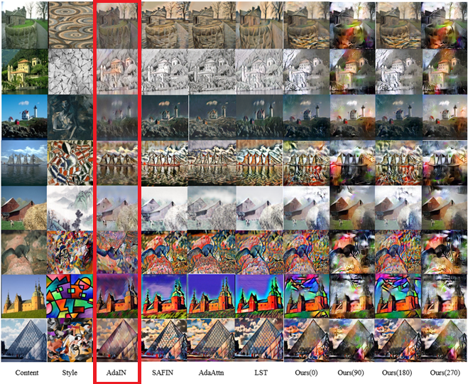
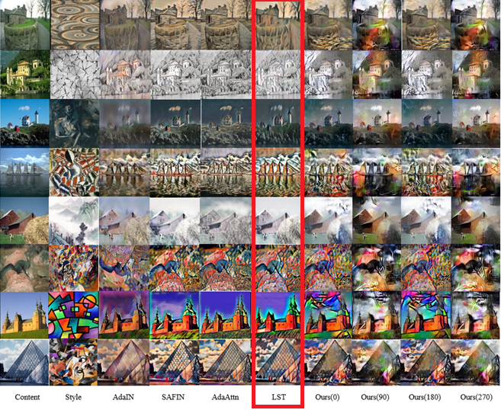
Comparison with State-of-the-Art Methods

Slide 19
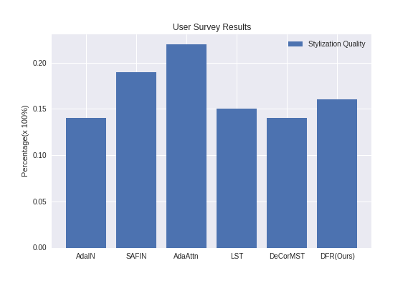
User Study
15 content images from MSCOCO dataset, and 20 style images from WikiArt dataset.
600 votes from 30 people
19

Slide 20
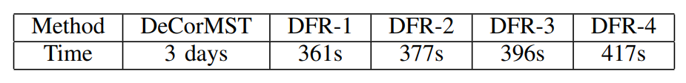
Efficiency
.
RUNNING TIME COMPARISON BETWEEN MULTIMODAL METHODS.
DFR-X equivalent to the number of outputs generated

Slide 21
5. Future Work
21

Slide 22
Generate more diverse images
Produces better quality images
Reduce inference time

Slide 23
Thanks!
Source code:
https://github.com/sonnguyen129/deep-feature-rotation
Any questions?

